Slide 1

World Kid Lit
Reading Challenge Award
2025 entry guidelines
Creative Commons 2025. Please share and name World Kid Lit CIC as the source

Slide 2

Firstly, what is World Kid Lit?
world kid lit = world literature for young people!
Every September, World Kid Lit Month is the time to
Explore global diversity through reading
Read and share books from beyond your country
Inspire curiosity in young people to become globe-trotting readers
The Reading Challenge Award and World Kid Lit Month (September) are run by World Kid Lit CIC, a UK-based non-profit community interest company that aims to improve awareness of and access to inclusive, international literature for young people

Slide 3
What is the World Kid Lit Reading Challenge Award?
This is a new competition for schools to promote international and inclusive reading
Run a World Kid Lit Reading Challenge in your school, where pupils/students read a range of books from (or set in) other countries, and then share what they have read in a reflective display or presentation
Schools are rewarded for the most imaginative, innovative or inclusive presentations where students reflect on what they’ve read

Slide 4
What are the 3 award categories?
Three prizes will be awarded, each for one age category:
Younger category
The books awarded are for children aged 0-6
For preschools / kindergarten / elementary / lower primary
Middle category
The books awarded are for children aged 7-12
For junior school s/ middle schools
Older category
The books awarded are for children aged 13+
For secondary / high schools

Slide 5
Can we enter more than one category?
Yes. If your Reading Challenge project includes students across the age brackets, you can submit up to three entries for the World Kid Lit Reading Challenge Award:
Younger category 0-6
Middle category 7-12
Older category 13+
The main factor to consider when entering a category is what type of books you would prefer to win, if your school won the Award.
For example, if your school’s project includes students aged 11-16, but would you prefer to receive a book bundle of teen/YA books, if your school won, then it’s best to enter the 13+ category

Slide 6
WHY run a World Kid Lit Reading Challenge?
Promote reading for pleasure - nothing like a competitive challenge to get young people reading!
Creativity - schools can choose the scale and scope of their challenge, when they run it, and how they present the results
Global inclusion - find out about the world’s best books in translation from other languages, and books in English from or set in other countries
Whole school engagement - all ages can take part including staff
Diversifying the curriculum - your school’s challenge could be a standalone reading for pleasure project, or integrated into the curriculum for English, history, geography, religious studies, art, foreign languages…

Slide 7
Does the Reading Challenge have to be in September?
No! You can run your reading challenge when it suits your school calendar.
Some examples …
1-day challenge to see how many countries you can visit by book , e.g. on World Book Day (March/April)
1-week challenge, e.g. reading around Europe for European Day of Languages (26 Sept), or reading refugee stories for Refugee Week in June
1-month read around the world challenge in September
6–week/3-month long globe-trotting reading challenge over the summer (depending on how long your school’s summer vacation is!)
1-year reading challenge over the course of the school year
7-year reading challenge following a class throughout primary school. How many countries can your class travel to by book over 7 years?!

Slide 8
Should the Reading Challenge involve the whole school?
Not necessarily. The challenge can involve as many or few young people as you like. It could be one class, one year group, or the whole school
It could be a project just for one group of students requiring additional support with reading
But bear in mind the judging criteria: one criterion is the number of pupils participating and how they participated
It could even be a challenge just for staff: this could win the Award if it’s an innovative presentation that inspires curiosity in readers

Slide 9
How do schools enter the Award?
Plan and run your World Kid Lit Reading Challenge at any point of the year, aiming to have a display or write-up ready to share by early October
The display or write-up could be
  online (e.g. in a school newsletter, a blog, the school website, on social media), or a
  physical display (e.g. a wall or window display in the library or classroom, an art installation, an assembly or performance) which is photographed or videoed
Between 1 September and 10 October 2025, submit photos and/or videos of your display or a link to your write-up to the judging committee at World Kid Lit using the online form (the URL will be published when the prize opens for entries 1 September 2025)

Slide 10

When will the winners be announced?
The 3 winning schools will be announced by mid-November
Prizes will be sent out in late November

Slide 11

What are the prizes?
Each of the 3 winning schools receive
An international book bundle of 10 books for the school library: two books for each continent (Africa, Americas, Asia, Europe, Oceania)
A certificate for the school

Slide 12
Does it cost to enter?
No, it is free to enter the Reading Challenge Award!
The main costs for schools are acquiring books for students (and staff) to read, and making a display or presentation
See this slide for more ideas of how to obtain international books on a budget:
>> How can we obtain books for our school?

Slide 13
What sort of books should we read?
Anything you like! The Award is for schools and settings where English is one of the main spoken languages, but the books read could include books written in English, ones translated into English, and ones in other languages.
At World Kid Lit, we think of ‘world literature for young people’ as including:
Books translated into English from another language
Books first published in English outside of the UK and USA
Books by authors from a different country than your own
Books by authors set in a different country than your own, by authors with lived experience of that country and culture
Bilingual books, and stories and poetry exploring bilingual and mixed heritage families

Slide 14
What are the judging criteria?
To encourage schools to think creatively about reading diversely and internationally, and to encourage broad participation (not just the most confident readers), the prizes are awarded taking into consideration the following criteria:
Number of books read as part of the school challenge
Number of countries explored/broadest geographic spread
Most innovative or imaginative display/presentation
Number of pupils participating and how they participated
Diversity - ethnic, linguistic, cultural & religious diversity of authors, illustrators, translators and book protagonists; diverse book genres & types
Reflection of the linguistic and ethnic diversity of your school community

Slide 15
Who are the judges?
To be confirmed by 1 September 2025 when the prize opens for entries

Slide 16
What are the books in the prize bundle?
This will be confirmed by 1 September 2025 when the prize opens for entries.
The books are generously provided by our publisher sponsors:

Slide 17
How can we obtain books for our school?
We appreciate that it is difficult to encourage students to read diversely if your school and library don’t have a diverse stock of books in the first place. Here are some ways to obtain books for a reading challenge
Inclusive Books for Children / Peters - 20% off IBC book packs (UK only)
Request books through your local School Library Service or local public library
Borrow ebooks through a library app such as BorrowBox
Ask your Parent-Teacher Association for support if you have one
Run a sponsored read or fundraising event to raise money for books
Seek out charities and local trusts giving funding for school projects, e.g. Give A Book

Slide 18
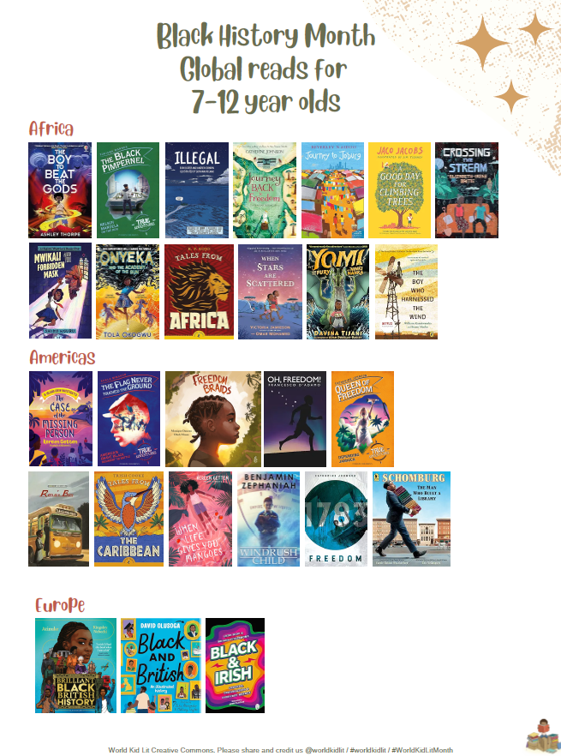
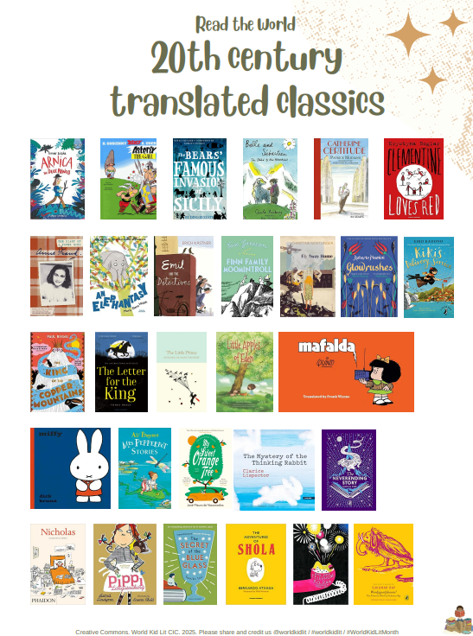
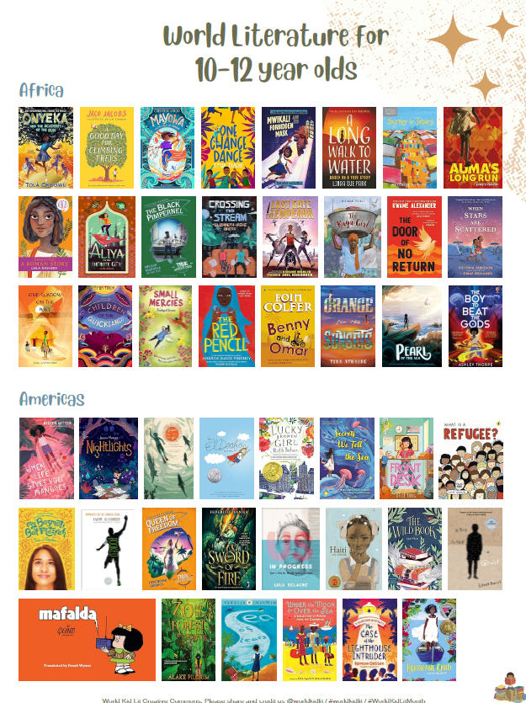
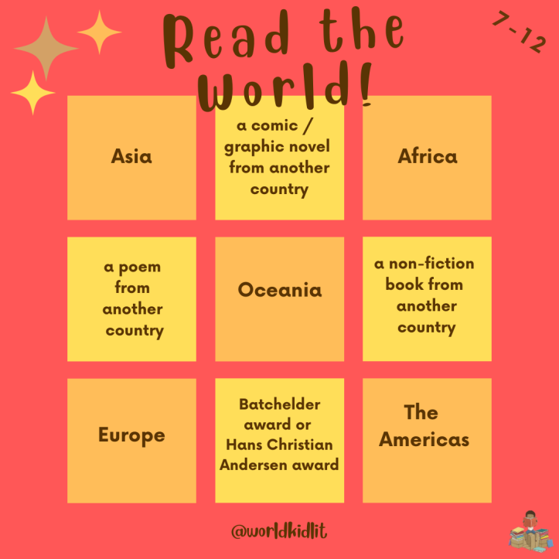
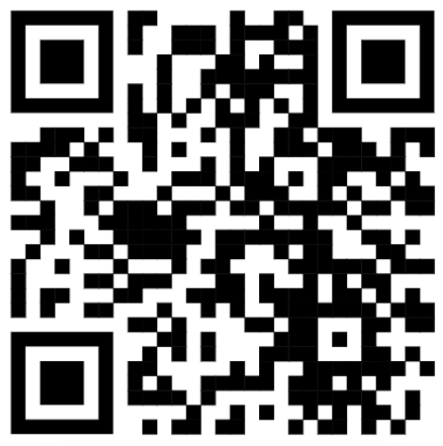
Where can we find ideas for books to read?
You’ll find many reading lists on our site. Some examples:
https://worldkidlit.org/

Slide 19
What is World Kid Lit Month?
Every September is World Kid Lit Month: an annual celebration of international literature for children and young adults
It’s the perfect time to read a children’s book from – or set in – another country, or a book translated into English from another language
Or to start a World Kid Lit Reading Challenge!
More information and graphics here https://worldkidlit.org/what-is-world-kid-lit-month/

Slide 20


Slide 21
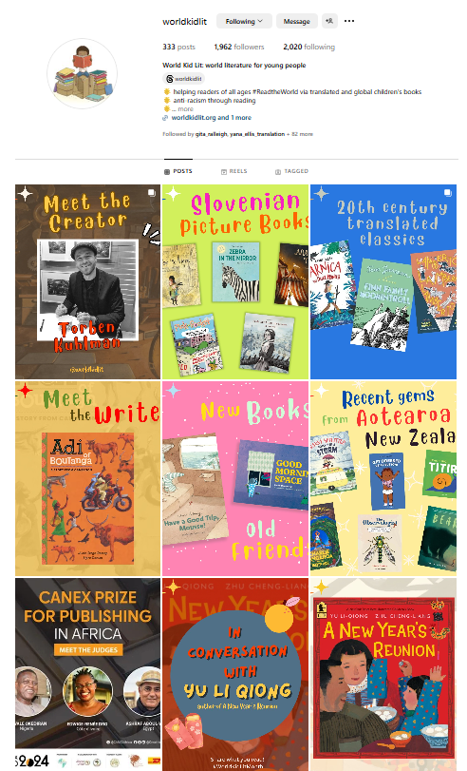
Find out more
https://worldkidlit.org/read-the-world-lists/
https://worldkidlit.org/what-is-world-kid-lit-month/
https://worldkidlit.org/annual-translation-lists/

Slide 22
